Slide 1
KEYWORD SPOTTING

Slide 2
Approaches used
Full Fine-Tuning of Whisper-Small on ATC Dataset
Fine-Tuning with LoRA for Hindi Dataset (Parameter-Efficient Training)
Whisper Baseline (Transcription → Translation → Keyword Spotting):

Slide 3
BASELINE MODEL
Whisper is a powerful general-purpose speech recognition model developed by OpenAI and released in 2022.
Whisper was trained on a large and diverse set of multilingual and multitask data collected from the web.
Whisper supports speech-to-text tasks in nearly 100 languages
Performs speech translation into English, making it one of the most versatile open-source ASR models.
Whisper was trained using 680,000 hours of supervised audio-transcription pairs.
Of this, approximately 117,000 hours are in English, while the remaining 563,000 hours consist of audio in other languages paired with their English translations.

Slide 4
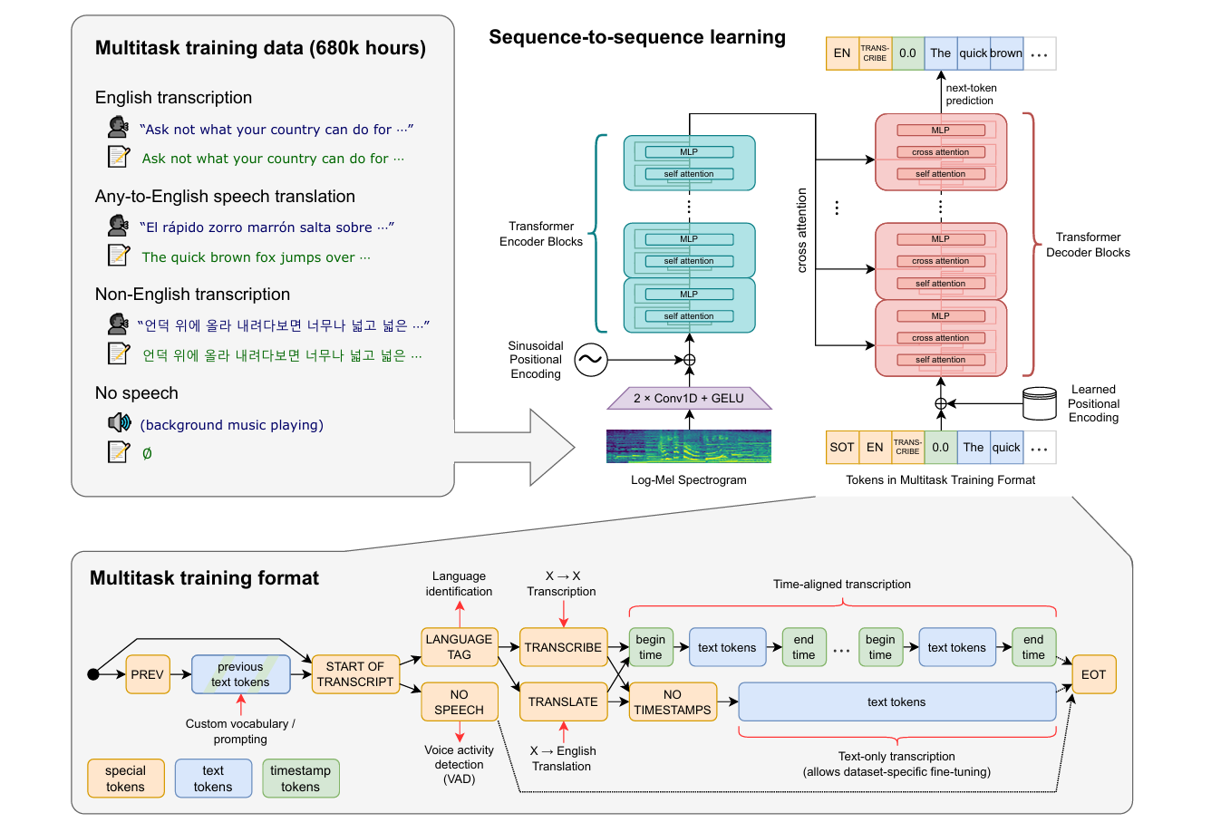
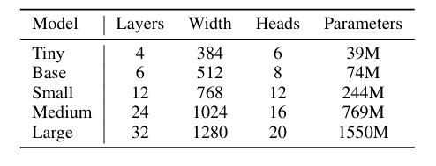
BASELINE MODEL
Table 1: Whisper model sizes
Figure 1: Overview of the Whisper model architecture

Slide 5
Approach 1: Fine-Tuning Whisper for ATCO Speech Recognition
In this approach, we fine-tune all parameters of the Whisper-small model using a domain-specific speech dataset composed of air traffic control (ATC) communications.
The goal is to specialize the model for transcription tasks in high-noise environments with aviation-specific terminology and speaker variability.
The training process involves preprocessing the audio to a 16 kHz sample rate, converting it into log-Mel spectrogram features, and updating the full model weights through supervised learning on transcribed ATC conversations.
This allows the model to learn domain-adapted acoustic and linguistic patterns, improving both transcription accuracy and downstream keyword spotting performance.
This approach can be similarly expanded to other domain specific datasets catering to military applications.

Slide 6
Approach 1: Fine-Tuning Whisper for ATCO Speech Recognition
Dataset:
Name: ATCO Speech Corpus Format: Parquet
Link: jacktol/atc-dataset · Datasets at Hugging Face
Train details:
- Base Model: openai/whisper-small - Optimizer: AdamW with learning rate 1e-5 - Epochs: 5 - Batch Size: 8 - Loss: CTC loss (inherent in Whisper) - Metric: Word Error Rate (WER)

Slide 7
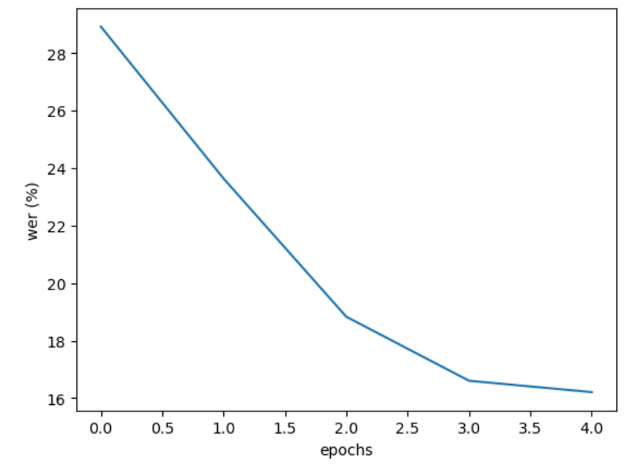
Approach 1: Fine-Tuning Whisper for ATCO Speech Recognition
Before Fine-Tuning
Average WER on 200 Validation Samples: 1.2165
During Fine-Tuning
WER reduced steadily across 5 epochs.
After Fine-Tuning
Final Average WER on 200 Validation Samples: 0.2837
Figure 2: WER vs Epochs

Slide 8
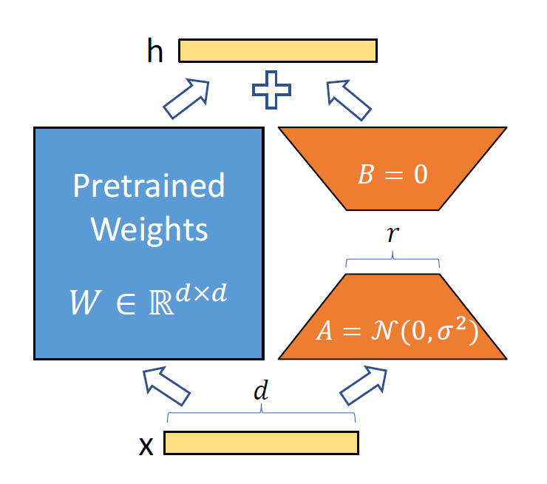
Approach 2: Fine-Tuning with LoRA
To address resource constraints and support low-resource languages, we adopt a parameter-efficient tuning technique using Low-Rank Adaptation (LoRA).
In this method, we freeze the majority of Whisper’s weights and introduce a small number of trainable rank-decomposition matrices into selected attention layers (e.g., query and value projections).
Only these additional parameters—amounting to roughly 1% of the full model—are updated during training on a Hindi-language dataset.
This significantly reduces memory usage and training time while allowing the model to adapt effectively to the linguistic characteristics of Hindi.
The resulting model remains lightweight yet capable of accurate transcription and keyword detection in Hindi speech.
Figure 3: Low-Rank Adaptation (LoRA) of Pretrained Weights via Randomized Parameter Injection

Slide 9
Approach 2: Fine-Tuning with LoRA
Experimental setup:
Dataset: Common voice 21 (Hindi dataset)
Train set: 9.38 hours
Test set: 4.73 hours
Train samples: 7563
Test samples: 3337
Train steps: 100
Trainable params: 15,728,640 || all params: 1,559,033,600 || trainable%: 1.0089

Slide 10
Approach 2: Fine-Tuning with LoRA
Results:
WER before finetuning:
WER on Train Set: 68.92%
WER on Test Set: 71.67%
WER after finetuning:
Train WER: 43.76%
Test WER: 47.22%
Step | Training Loss | Validation Loss
100 | 0.460100 | 0.316768

Slide 11
Approach 2: Fine-Tuning with LoRA
References:
Xu, Lingling, et al. "Parameter-efficient fine-tuning methods for pretrained language models: A critical review and assessment." arXiv preprint arXiv:2312.12148 (2023).
Hu, Edward J., et al. "Lora: Low-rank adaptation of large language models." ICLR 1.2 (2022): 3.
Radford, Alec, et al. "Robust speech recognition via large-scale weak supervision." International conference on machine learning. PMLR, 2023.

Slide 12
Approach 3: Whisper Baseline (Transcription → Translation → KWS)
In this approach, we use the pre-trained Whisper model directly, without any task-specific fine-tuning.
The model is first used to transcribe audio input in its native language.
If the audio is in a non-English language (e.g., Hindi), we translate the transcription into English.
Keyword spotting is then performed on the resulting English text using fuzzy string similarity and phonetic encoding..
This pipeline showcases ability to handle multilingual transcription and translation in a plug-and-play fashion, making it especially useful for rapid prototyping or low-resource scenarios.

Slide 13
Approach 3: Whisper Baseline (Transcription → Translation → KWS)
Whisper Model Setup
Model Used: openai/whisper-large-v3 - The Whisper model is loaded with WhisperProcessor and WhisperForConditionalGeneration. - Configured for Hindi transcription using forced decoder IDs.
Transcription
Audio is loaded and checked for correct sampling rate (16 kHz). Whisper transcribes the Hindi speech into text in Devanagari script.
Transliteration
A custom transliteration step uses the indicate.transliterate library to convert Devanagari words into Latin script (English phonetic equivalents). Only Devanagari words are transliterated.

Slide 14
Approach 3: Whisper Baseline (Transcription → Translation → KWS)
Hybrid Keyword Matching
A predefined keyword set includes English operational terms such as: {"report", "calling", "over", "guide", "army", "commandant", "wilko", "point", "checking", "vehicle", "namaste"} Matching is done via: - Fuzzy String Similarity (RapidFuzz): Matches if score ≥ 85% - Phonetic Encoding (Double Metaphone): Matches if phonetic representations match
Dataset used:
Sample audio files provided by DRDO

Slide 15
Approach 3: Whisper Baseline (Transcription → Translation → KWS)
Result:
Sample file: 🎧 File: clip001.wav 📝 Hindi: कॉलिंग प्वाइंट पर गाड़ी रिपोर्ट कर रही है 🔤 Latin: calling point par gaadi report kar rahi hai 🔎 Keywords found (≥85% similarity or phonetic match): calling ~ calling (100%, string), point ~ point (100%, string), report ~ report (100%, string)

